Slide 1
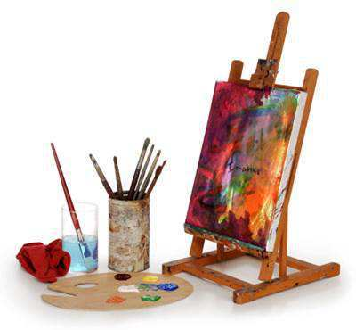
The World of Painting

Slide 2
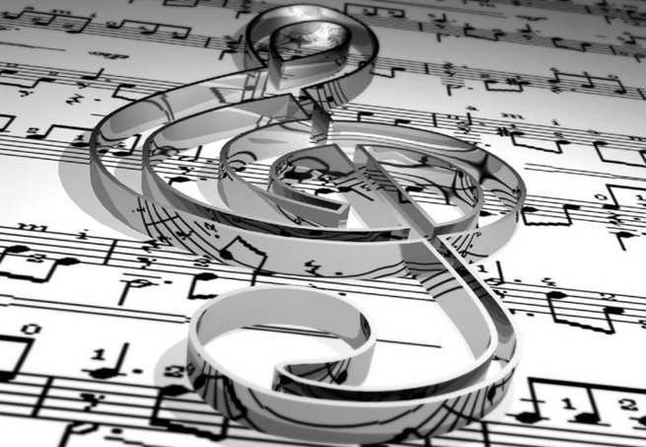
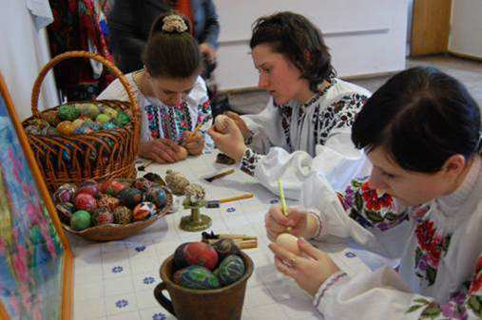
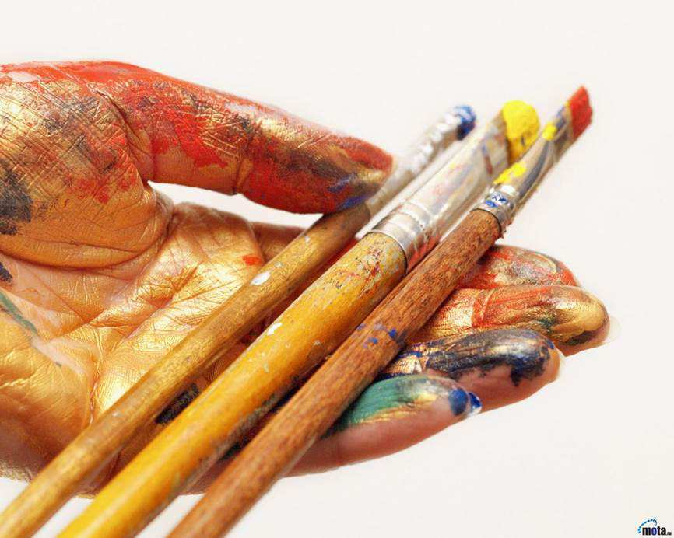
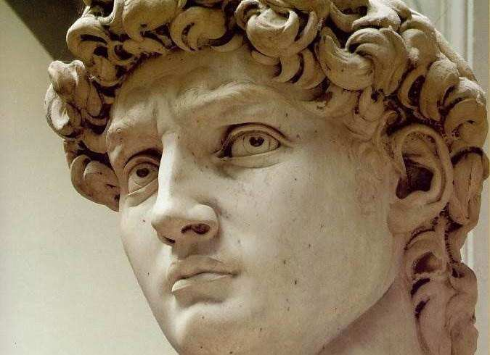

Our life seems to be impossible without art.

Slide 3
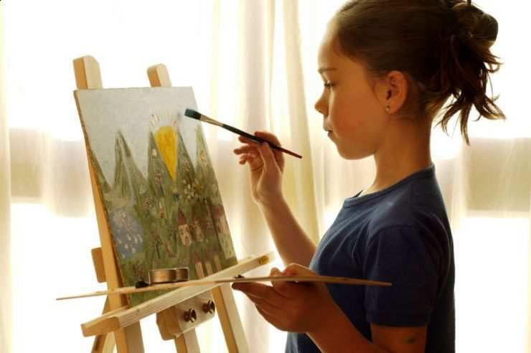
It really occupies an important part in our life. Art offers us not only pleasure and amusement but it is also a vehicle of culture and education. Art penetrates into all spheres and sides of our life. Art makes our life brighter, richer and more intellectual.

Slide 4
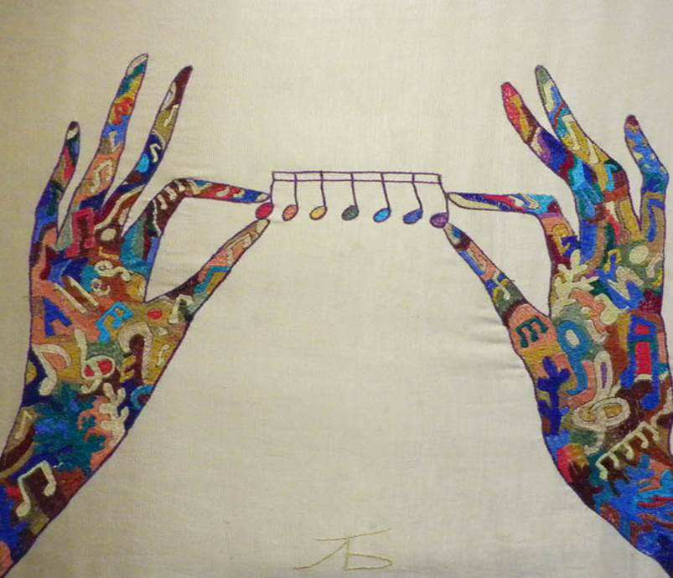
Art unites different people. It influences the development of personality. Art maker our inner world richer. It fills your soul with different feelings. It makes us stronger, enforces us in different situations. Time is flying art is forever!

Slide 5
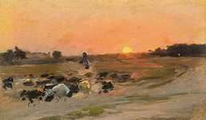
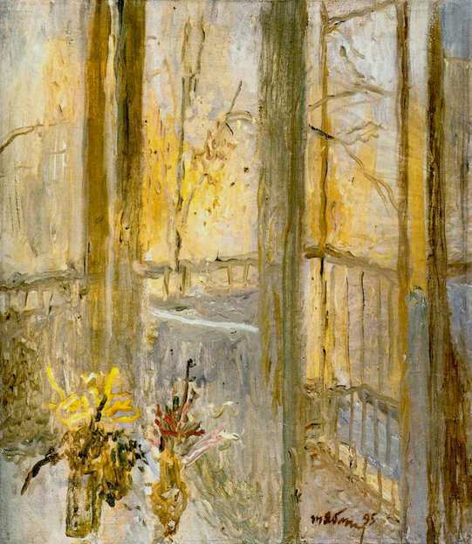
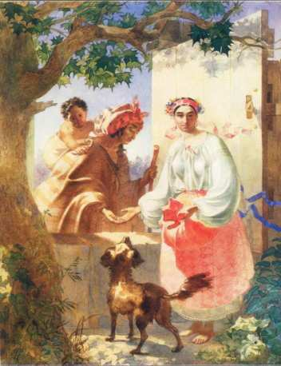
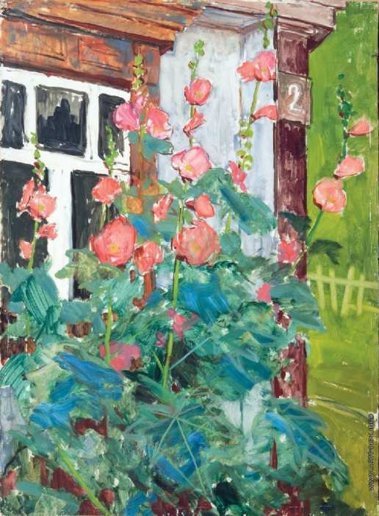
In the Ukrainian art has a lot of talented artists who have enriched our world is beautiful and brilliant paintings. One of them is T. Yablonska, Y. Bokchai, O. Shovkunenko, R. Selskyi, M. Pymonenko, T. Shevchenko and many others.
They became a unique phenomenon that has no analogues in the world and the Ukrainian art.

Slide 6
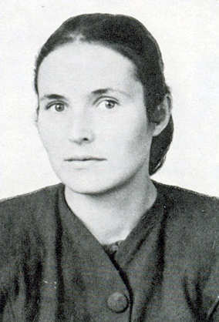
Tatiana Yablonskaya
His artistic career began as a follower of socialist realism, mainly in the subject compositions. She was attracted by the theme of active movement, work, sports. But a lot of work filled with lyricism, especially devoted to motherhood, subtle psychological portraits, self-portraits. Stylistically the writing Yablonsky was changed for the entire period of her long and fruitful life, in particular, in many works, you can feel her passion for impressionism.

Slide 7
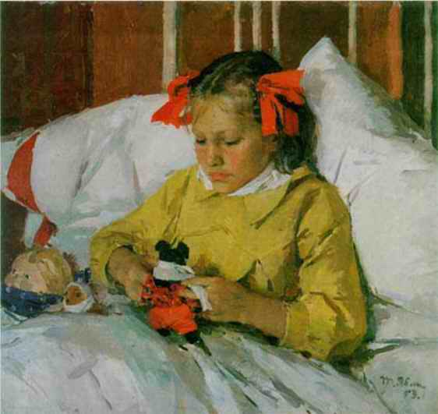
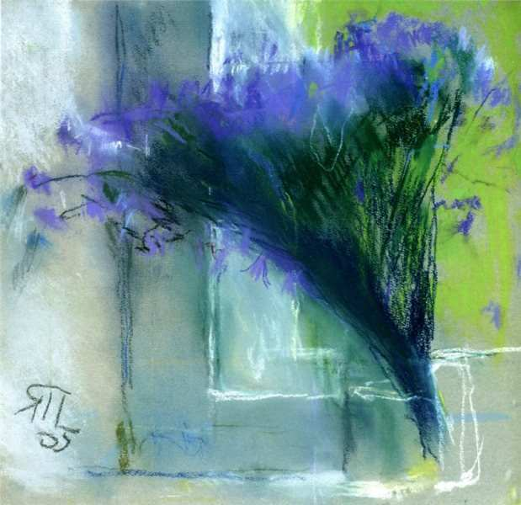
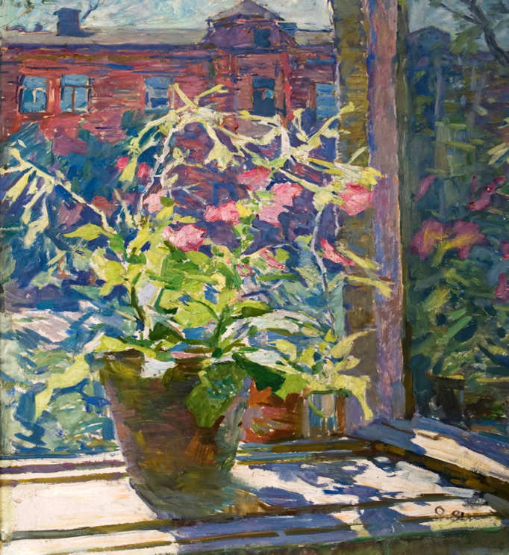
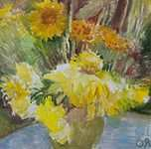
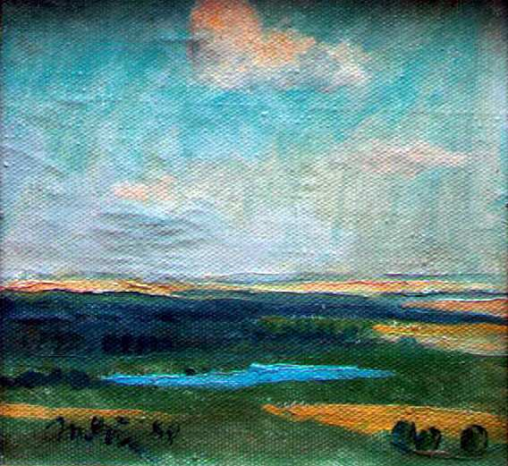

Slide 8
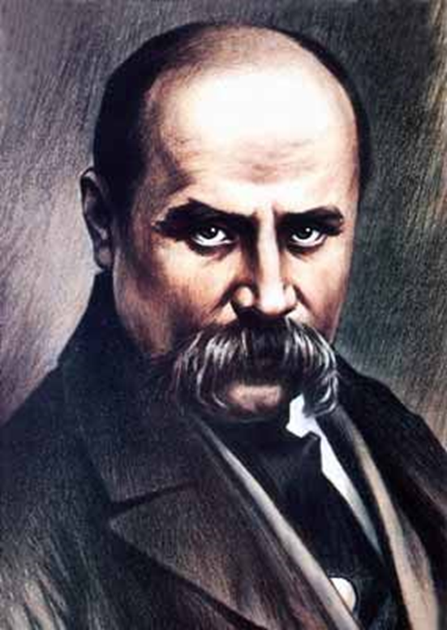
Taras Shevchenko
Paintings and graphic works by execution time dated for years 1830-1861. Genres - portraits, compositions on mythological, historical and everyday themes, architectural landscapes and scenery. Made in their writing technique of oil on canvas and watercolor, Sepia, ink, lead pencil and in the technique of etching on separate sheets of white, colored and tinted paper of different sizes and in five albums. A significant part of the artistic heritage Shevchenko are completed, but no less valuable for understanding a creative way and disclosure of the artist's creative method and its numerous sketches, sketches, sketches and training studios.

Slide 9
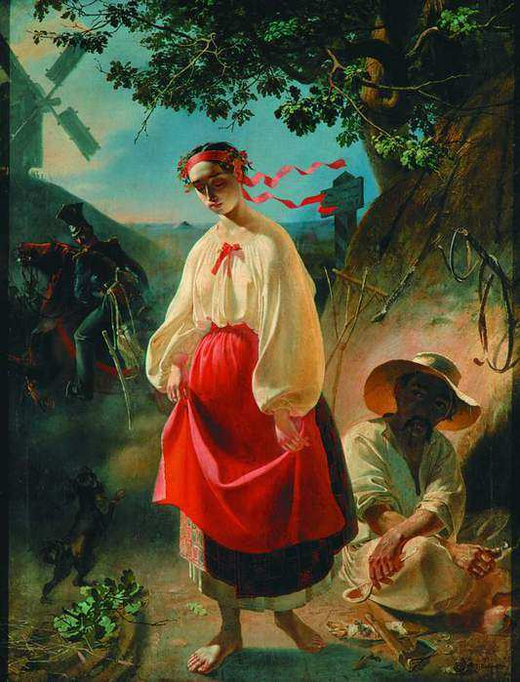
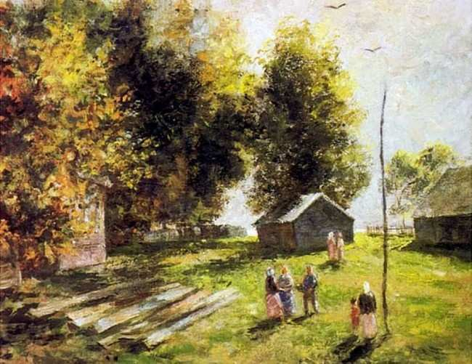
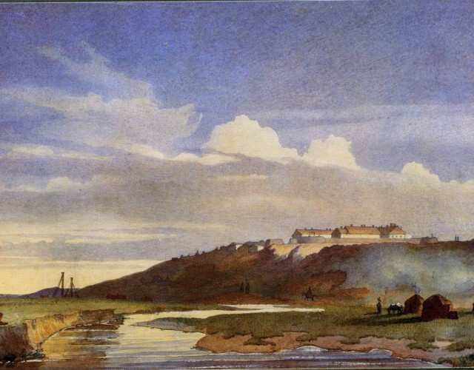
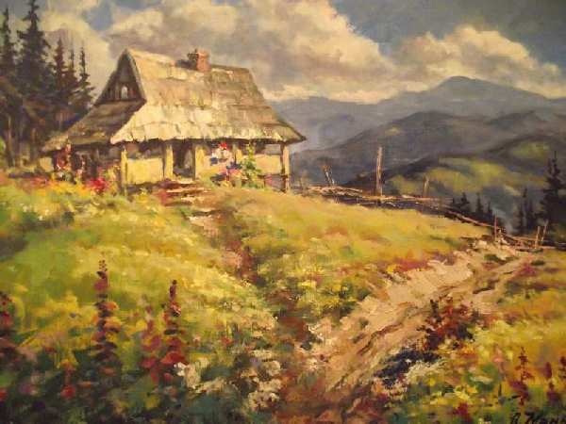

Slide 10

Thank you!!!

